Slide 1
The dance
Present by: Luisa rincón
FOR: Diana Escobar

Slide 2
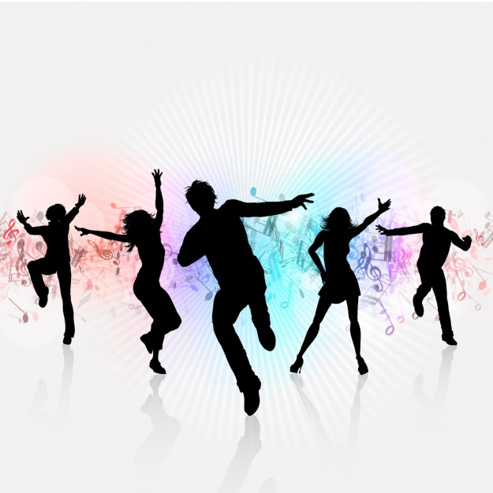
What is the dance?
It is an art where the movement of body parts is generally used with music, as a form of expression and social interaction, for entertainment, artistic or religious propones

Slide 3
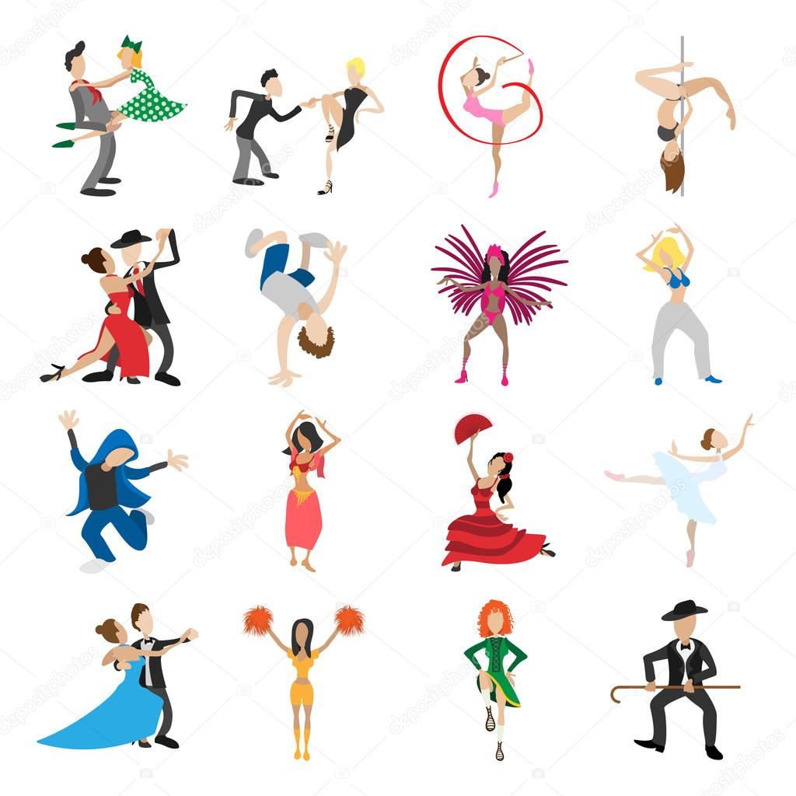
What are the types of dance?
1.Waltz
2.Tango
3.Cha Cha Cha
4.Rumba
5.Samba
6.Mambo
7.Academic Dance
8.Traditional dance
9.Modern dance
10.Which are

Slide 4
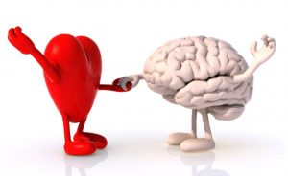
Benefits of dancing
1.The heart is strengthened.
2.Fight Alzheimer’s
3.Increase your memory
4.Allies in weight loss.
5.Reduce the cholesterol
6.Antidote against osteoporosis.
7.Flexibility, strength and resistance.
8.Eliminate stress
9.Increase the energy level

Slide 5
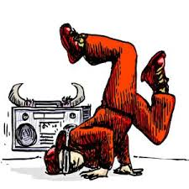
Modern and fashionable dances
They reflect their time and are the document of the real spirit of their time

Slide 6
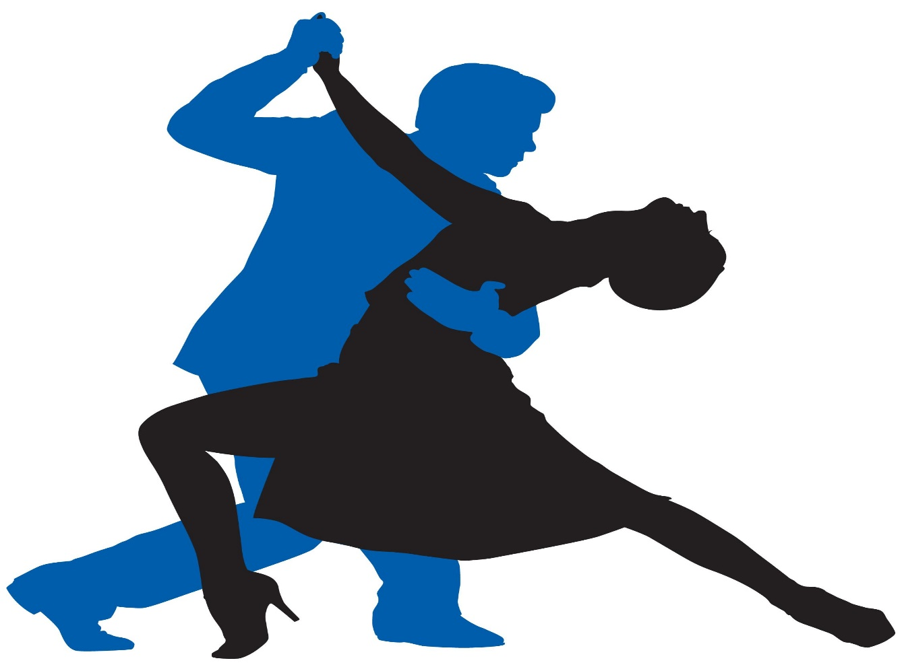
The end

