Slide 1
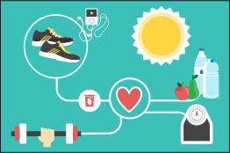

Healthy habits
Dayana Jimena Gomez Nieto
Maryan Lorena Melo Beltran
Luisa Fernanda Rincon Petro
1001

Slide 2
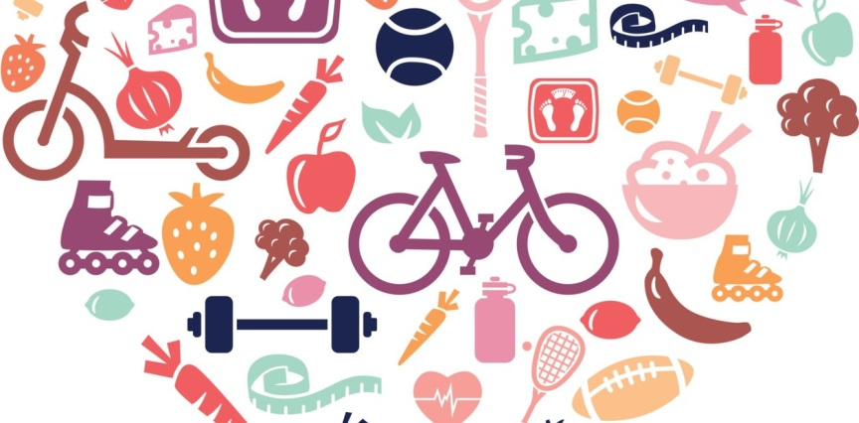
HEALTHY HABITS
healthy habits to all those behaviors that we have assumed as our own in our daily life and that positively affect our physical, mental and social well-being. Sayings habits are mainly food, rest and the practice of physical activity correctly planned.

Slide 3

INDIVIDUAL HYGIENIC HABITS
body hygiene:daily cleaning of the skin by showering, brushing teeth after each meal
Drees:you should wear clean, comfortable and appropriate clothing that is going to be carried out; The footwear must be breathable comfortable, and adequate to carry out the activity

Slide 4
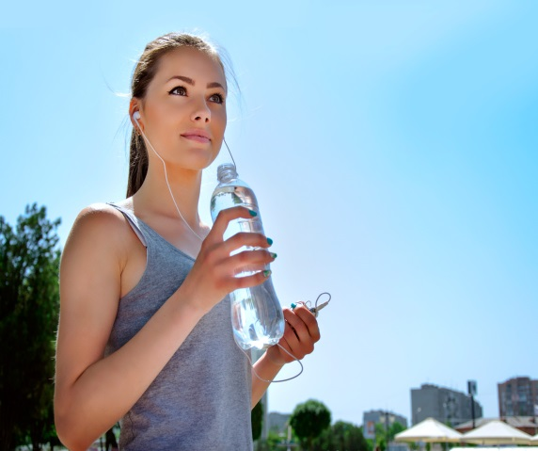
COLLECTIVE HYGIENIC HABITS
during the practice of physical activity: be well hydrated, keep the facilities clean and in good material condition, communicate to the teacher or the person in charge of material any incident with this
the urban environment: make good use of bins, respect spaces, avoid making annoying noises for others, pick up any waste or garbage that falls on the ground

Slide 5
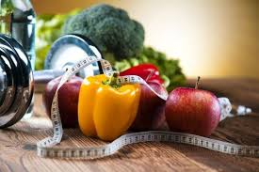
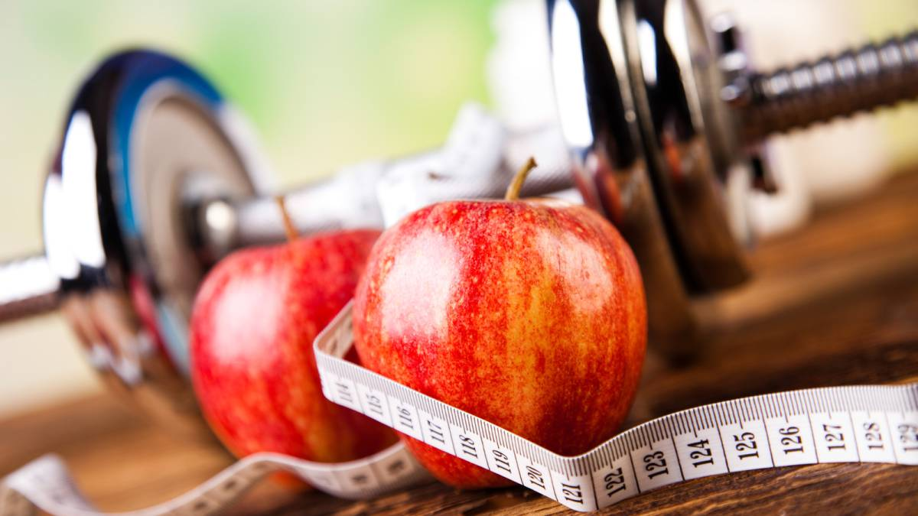
FEEDING HABITS
they are defined as daily routine that accompanies the act of eating: it includes schedules, quantities, type of food, preparations and tastes

Slide 6

TIPS FOR A HEALTHY FOOD
personal hygiene and the place where we eat
the time destined to eat: you should not eat in a hurry, you have to chew and eat calmly, but not excessively, since otherwise it can lead to gastric problems (ulcers, hernias ETC ....)
you must make at least four meals a day (breakfast, lunch, snack and dinner) and with a set schedule
not eat before or immediately after physical exercise

